Slide 1
SQL Injection Attack

Slide 2
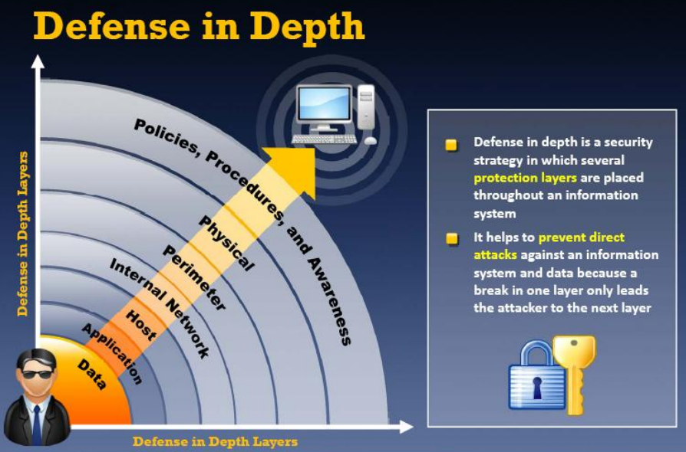

Slide 3
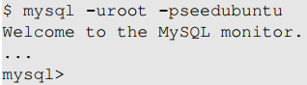
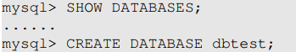
Brief Tutorial of SQL
Log in to MySQL: We will use MySQL database, which is an open-source relational database management system. We can log in using the following command:
Create a Database: Inside MySQL, we can create multiple databases. “SHOW DATABSES” command can be used to list existing databases. We will create a new database called dbtest:
Notes:
SQL commands are non-case sensitive, but we capitalize them to separate them from non-commands in lowercase

Slide 4
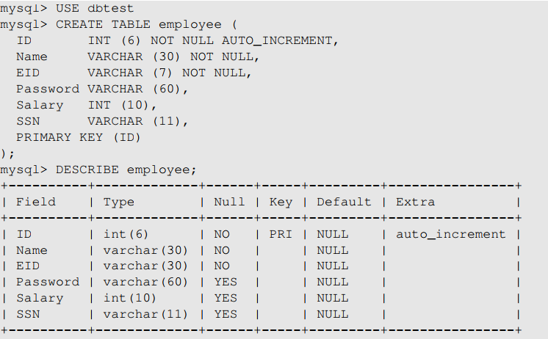
SQL Tutorial: Create a Table
A relational database organizes its data using tables. Let us create a table called employee with seven attributes (i.e. columns) for the database “dbtest”
We need to let the system know
which database to use as there
may be multiple databases
After a table is created, we can use
describe to display the structure
of the table
Notes:
Syntax explanation:
Table columns are defined inside parentheses after the table name
Each column definition starts with its name, followed by the data type
The number association with the data type specifies the maximum length for the data in the column
Use example of column “ID” to explain the same
Data type
Not Null
Auto increment

Slide 5
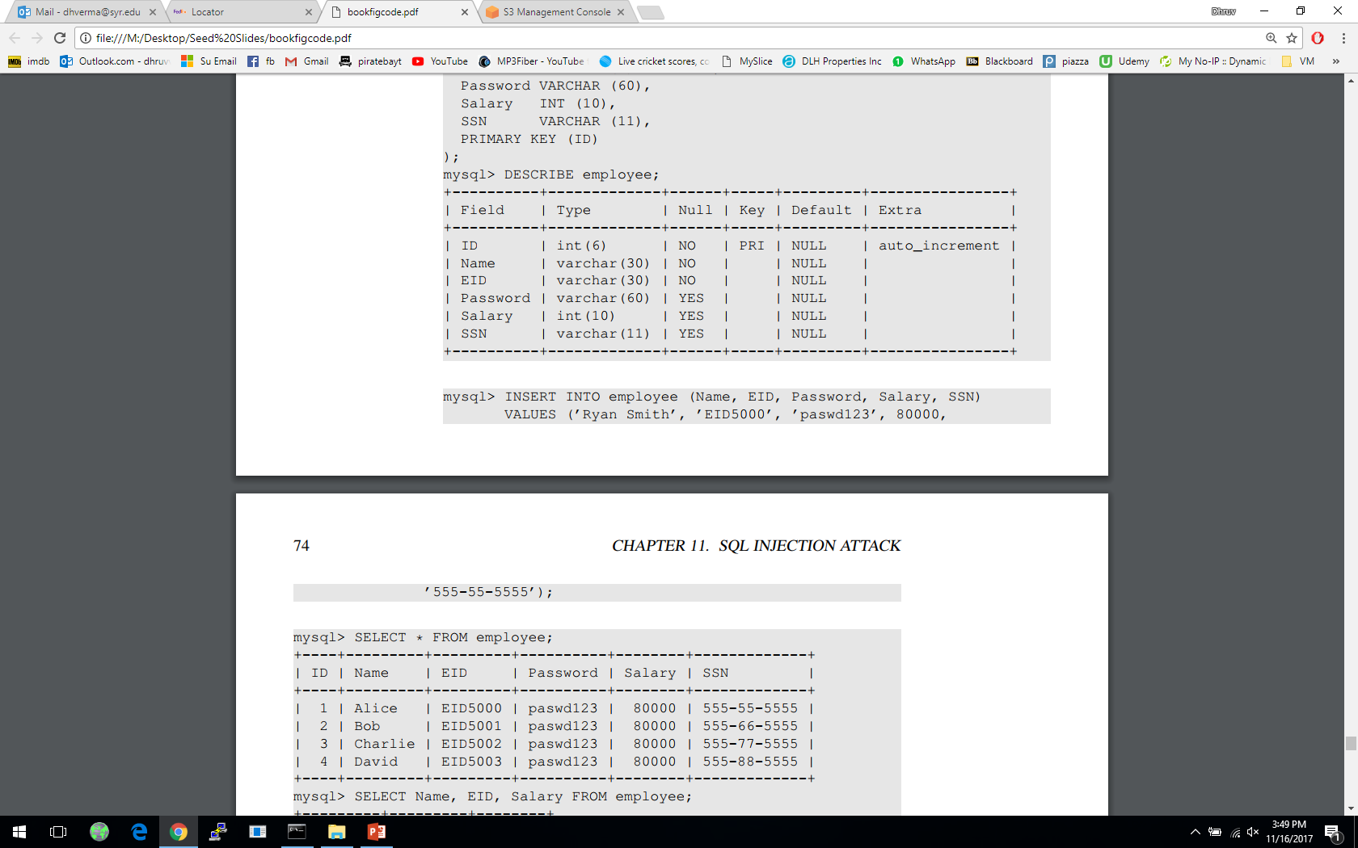
SQL Tutorial: Insert a Row
We can use the INSERT INTO statement to insert a new record into a table :
Here, we insert a record into the “employee” table.
We do not specify a value of the ID column, as it will be automatically set by the database.
Notes:
SQL commands are non-case sensitive, but we capitalize them to separate them from non-commands in lowercase

Slide 6
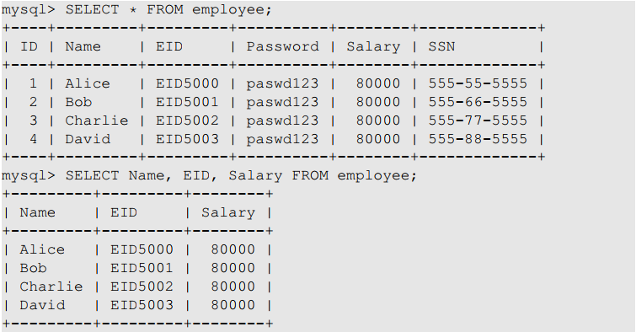
SQL Tutorial: SELECT Statement
The SELECT statement is the most common operation on databases
It retrieves information from a database
Asks the database for all its records, including all the columns
Asks the database only for Name, EID and Salary columns

Slide 7
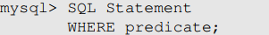
SQL Tutorial: WHERE Clause
It is uncommon for a SQL query to retrieve all records in a database.
WHERE clause is used to set conditions for several types of SQL statements including SELECT, UPDATE, DELETE etc.
The above SQL statement only reflects the rows for which the predicate in the WHERE clause is TRUE.
The predicate is a logical expression; multiple predicates can be combined using keywords AND and OR.
Lets look at an example in the next slide.

Slide 8
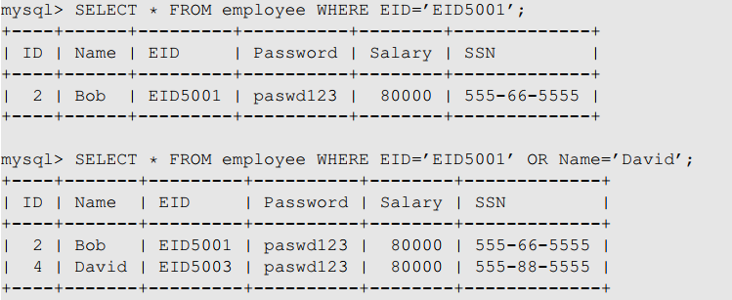
SQL Tutorial: WHERE Clause
The first query returns a record that has EID5001 in EID field
The second query returns the records that satisfy either EID=‘EID5001’ or Name=‘David’

Slide 9

SQL Tutorial: WHERE Clause
If the condition is always True, then all the rows are affected by the SQL statement
This 1=1 predicate looks quite useless in real queries, but it will become useful in SQL Injection attacks

Slide 10
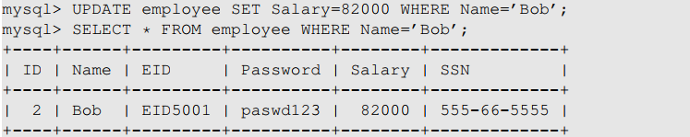
SQL Tutorial: UPDATE Statement
We can use the UPDATE Statement to modify an existing record

Slide 11
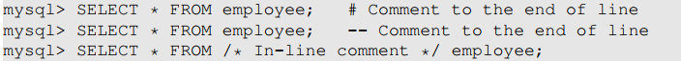
SQL Tutorial: Comments
MySQL supports three comment styles
Text from the # character to the end of line is treated as a comment
Text from the “--” to the end of line is treated as a comment.
Similar to C language, text between /* and */ is treated as a comment

Slide 12
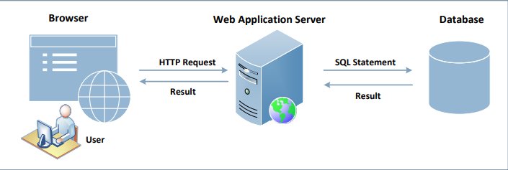
Interacting with Database in Web Application
A typical web application consists of three major components:
SQL Injection attacks can cause damage to the database. As we notice in the figure, the users do not directly interact with the database but through a web server. If this channel is not implemented properly, malicious users can attack the database.
Notes:
Explanation of the components:
Web Browser: Browser is on the client side, its primary function is to get content from the web server, present the content to the user, interact with the user and get the user inputs
Web Application server: They are responsible for generating and delivering content to the browser. They usually rely on an independent database server for data management
Browsers communicate with web servers using the Hypertext Transfer Protocol, while web servers interact with databases using database languages, such as SQL

Slide 13
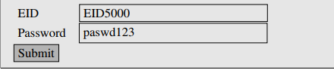

Getting Data from User
This example shows a form where users can type their data. Once the submit button is clicked, an HTTP request will be sent out with the data attached
The HTML source of the above form is given below:
Request generated is:
Notes:
Depending on whether the HTTP request is a GET or POST request, the ways how data are attached are different.

Slide 14

Getting Data from User
The request shown is an HTTP GET request, because the method field in the HTML code specified the get type
In GET requests, parameters are attached after the question mark in the URL
Each parameter has a name=value pair and are separated by “&”
In the case of HTTPS, the format would be similar but the data will be encrypted
Once this request reached the target PHP script the parameters inside the HTTP request will be saved to an array $_GET or $_POST. The following example shows a PHP script getting data from a GET request

Slide 15
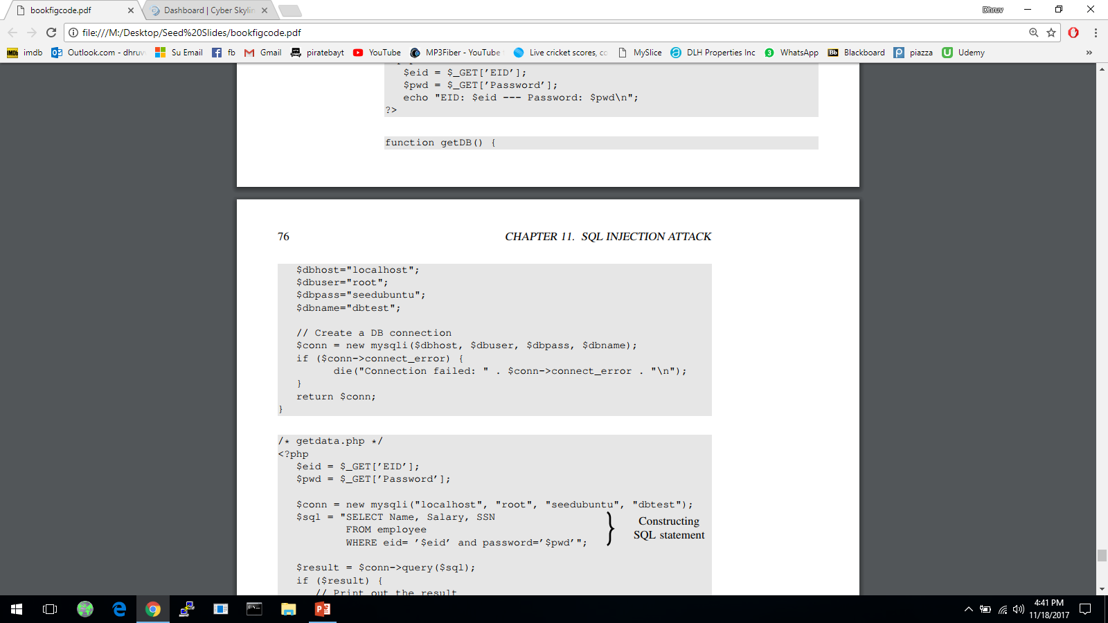
How Web Applications Interact with Database
Connecting to MySQL Database
PHP program connects to the database server before conducting query on database using.
The code shown below uses new mysqli(…) along with its 4 arguments to create the database connection.
Notes:
Web apps store data in databases and fetch additional data based on given input from database.
3 main methods for PHP programs to interact with a MySQL database:
PHP’s MySQL Extension
PHP’s MySQLi Extension [commonly used]
PHP Data Objects
MySQLi extension allows PHP programs to access the functionality provided by MySQL 4.1 and above.
4 arguments of mysqli: hostname of database server, login name, password and the database name.
The hostname depends on where the database is run. If on same machine as the web app server then we use “localhost”.

Slide 16
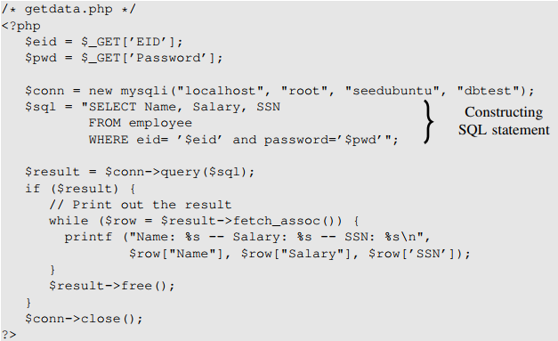
How Web Applications Interact with Database
Construct the query string and then send it to the database for execution.
The channel between user and database creates a new attack surface for the database.
Notes:
Code shows how query string is constructed, executed, and how the queried results are obtained.
Data typed in form, eventually become part of the SQL string executed by database.
Even though user doesn’t directly interact with the database, there does exists a channel between the user and the database.
If not protected properly, user may be able to launch attacks on the database through channel.

Slide 17
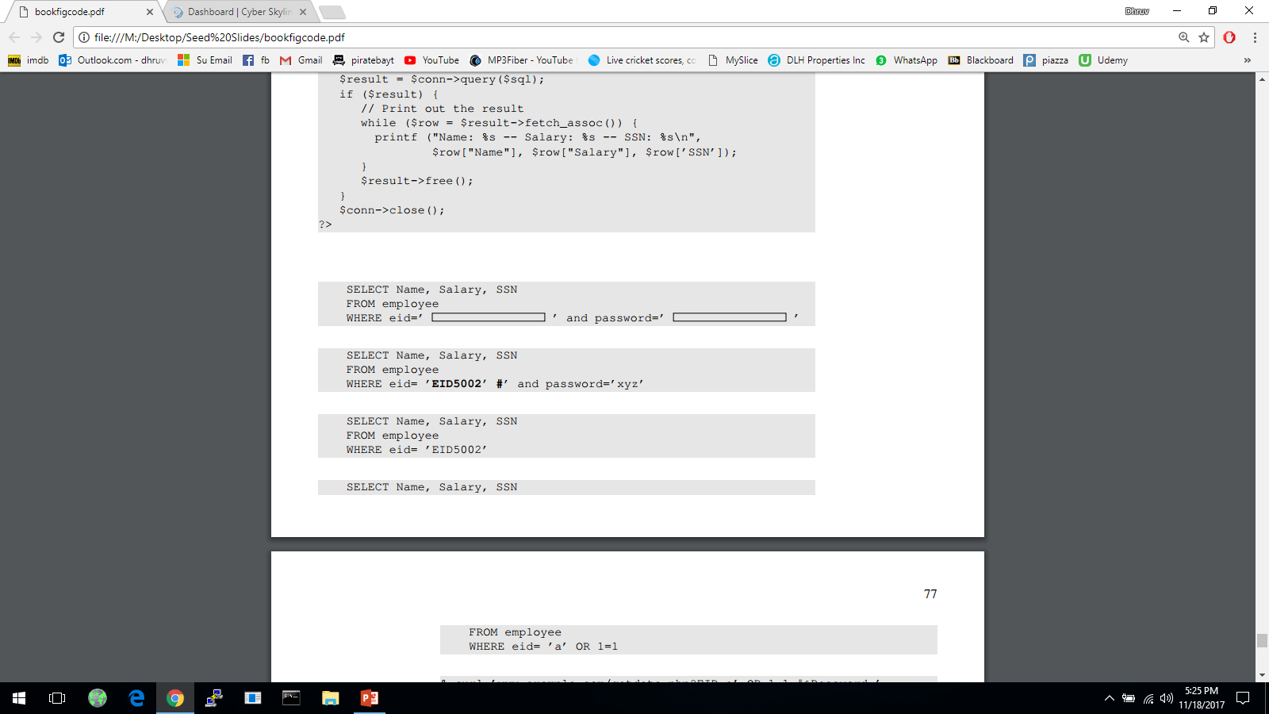
Launching SQL Injection Attacks
Everything provided by user will become part of the SQL statement. Is it possible for a user to change the meaning of the SQL statement?
The intention of the web app developer by the following is for the user to provide some data for the blank areas.
Assume that a user inputs a random string in the password entry and types “EID5002’#” in the eid entry. The SQL statement will become the following
Notes:
To understand possible attacks, we consider the abstract version of the web app creates a SQL statement template and a user needs to fill in the blanks inside the rectangle area.
The attack demonstrated shows the user taking help of some special characters to change the meaning of the SQL statement.

Slide 18

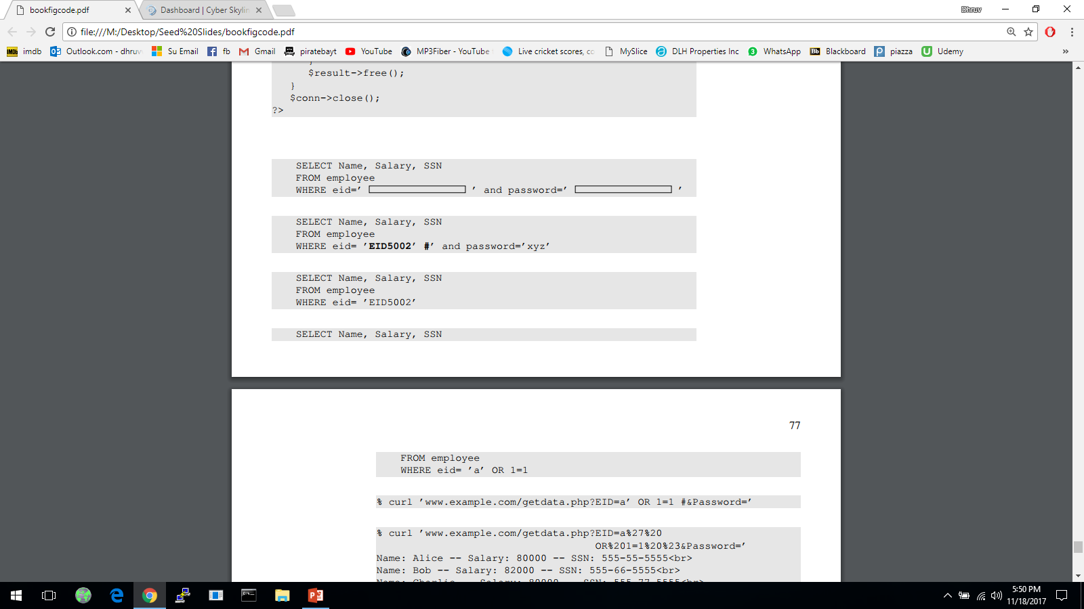
Launching SQL Injection Attacks
Everything from the # sign to the end of line is considered as comment. The SQL statement will be equivalent to the following:
The above statement will return the name, salary and SSN of the employee whose EID is EID5002 even though the user doesn’t know the employee’s password. This is security breach.
Let’s see if a user can get all the records from the database assuming that we don’t know all the EID’s in the database.
We need to create a predicate for WHERE clause so that it is true for all records.

Slide 19
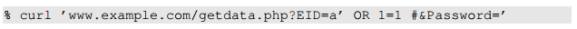

Launching SQL Injection Attacks using cURL
More convenient to use a command-line tool to launch attacks.
Easier to automate attacks without a graphic user interface.
Using cURL, we can send out a form from a command-line, instead of from a web page.
The above command will not work. In an HTTP request, special characters are in the attached data needs to be encoded or they maybe mis-interpreted.
In the above URL we need to encode the apostrophe, whitespace and the # sign and the resulting cURL command is as shown below:
Notes:
In the previous section, we launch attacks using forms. Here we see how to perform those attacks using command-line tools.
cURL- widely used command-line tool for sending data over a number of network protocols, including HTTP and HTTPS.
URL syntax also uses some special characters so if the special characters attached to data is not encoded, it will be mis-interpreted.
Encoding for space is %20
Encoding for # is %23
Encoding for apostrophe is %27

Slide 20
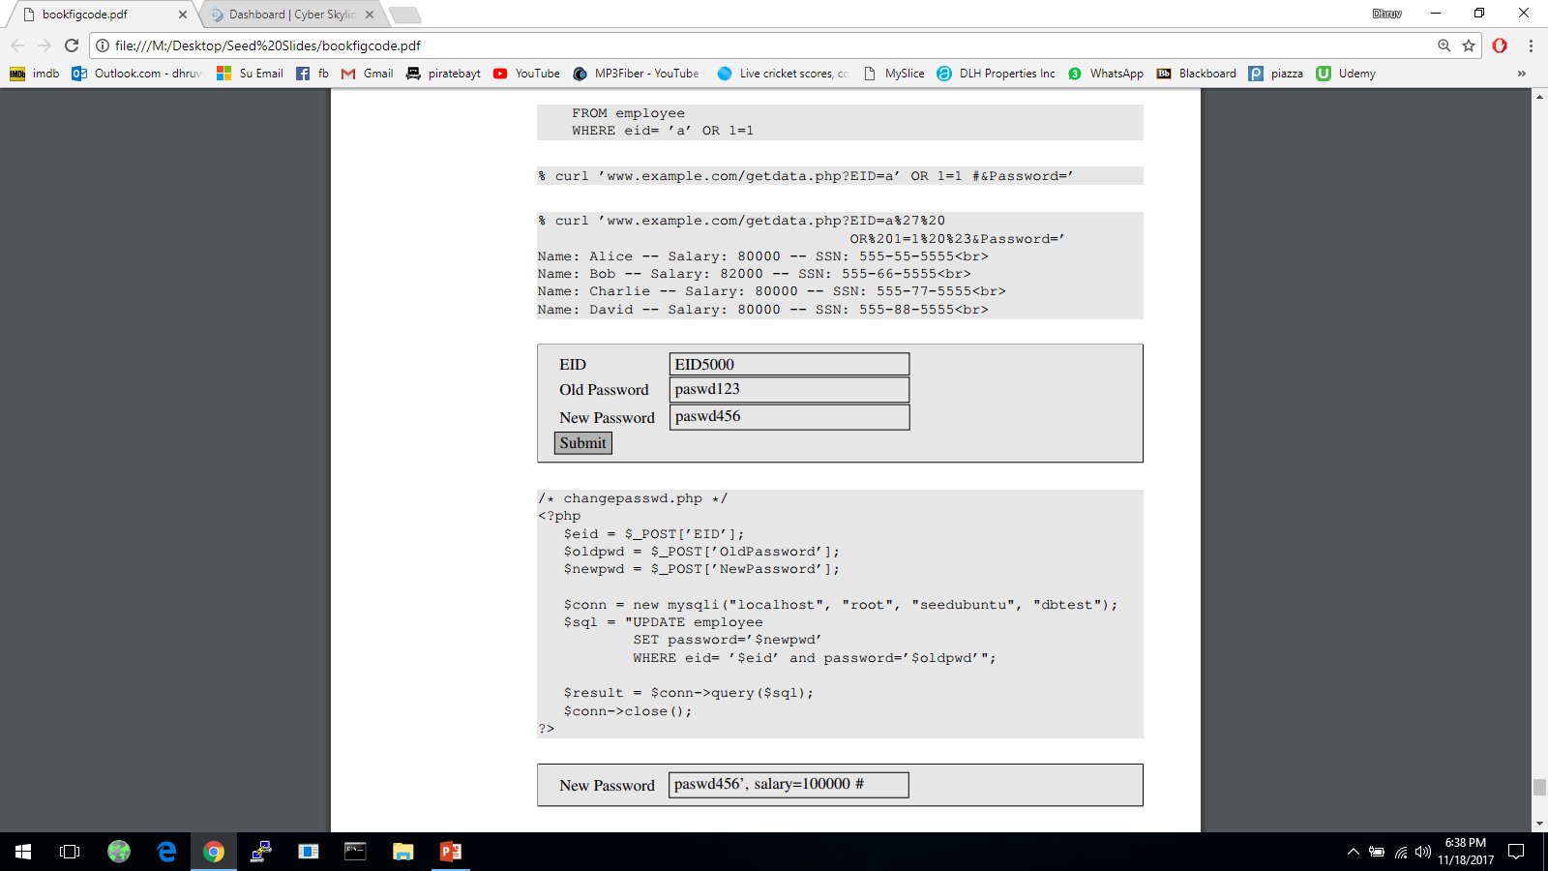
Modify Database
If the statement is UPDATE or INSERT INTO, we will have chance to change the database.
Consider the form created for changing passwords. It asks users to fill in three pieces of information, EID, old password and new password.
When Submit button is clicked, an HTTP POST request will be sent to the server-side script changepassword.php, which uses an UPDATE statement to change the user’s password.

Slide 21
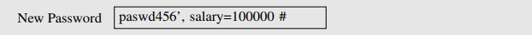


Modify Database
Let us assume that Alice (EID5000) is not satisfied with the salary she gets. She would like to increase her own salary using the SQL injection vulnerability. She would type her own EID and old password. The following will be typed into the “New Password” box :
By typing the above string in “New Password” box, we get the UPDATE statement to set one more attribute for us, the salary attribute. The SQL statement will now look as follows.
What if Alice doesn’t like Bob and would like to reduce Bob’s salary to 0, but she only knows Bob’s EID (eid5001), not his password. How can she execute the attack?
Notes:
User inputs are used to construct the SQL statement, hence there is a SQL injection vulnerability.
A single UPDATE statement can set multiple attribute of a matching record, if a list of attributes, separated by commas, is given to the SET command.
The SQL statement in changepassword.php is meant to set only one attribute, the password attribute.
The intention of the PHP script is to change the password attribute. Due to SQL injection vulnerability, attackers can make changes to other attributes (here, salary).

Slide 22

Multiple SQL Statements
Damages that can be caused are bounded because we cannot change everything in the existing SQL statement.
It will be more dangerous if we can cause the database to execute an arbitrary SQL statement.
To append a new SQL statement “DROP DATABASE dbtest” to the existing SQL statement to delete the entire dbtest database, we can type the following in the EID box
The resulting SQL statement is equivalent to the following, where we have successfully appended a new SQL statement to the existing SQL statement string.
The above attack doesn’t work against MySQL, because in PHP’s mysqli extension, the mysqli::query() API doesn’t allow multiple queries to run in the database server.

Slide 23
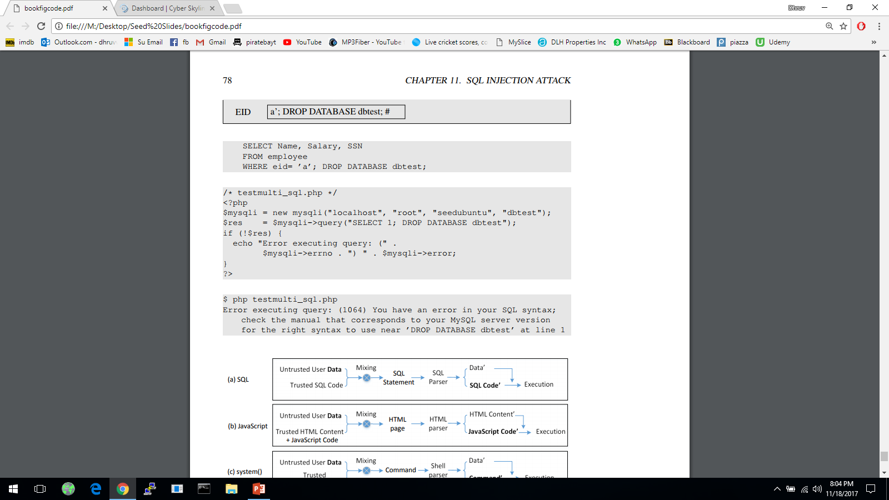
Multiple SQL Statements
The code below tries to execute two SQL statements using the $mysqli->query() API
When we run the code, we get the following error message:
If we do want to run multiple SQL statements, we can use $mysqli -> multi_query(). [not recommended]
Notes:
For the sake of security, we should avoid using the $mysqli->multi_query() API in codes, especially if the SQL statement string contains untrusted data.

Slide 24
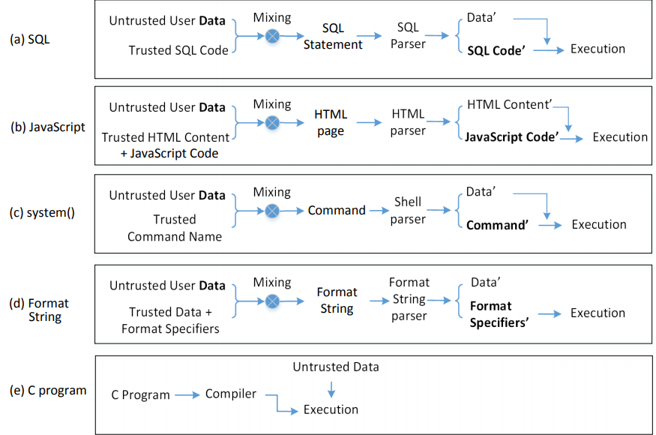
The Fundamental Cause
Mixing data and code together is the cause of several types of vulnerabilities and attacks including SQL Injection attack, XSS attack, attacks on the system() function and format string attacks.
Notes:
See the book for detailed discussion of this diagram

Slide 25

Countermeasures: Filtering and Encoding Data
Before mixing user-provided data with code, inspect the data. Filter out any character that may be interpreted as code.
Special characters are commonly used in SQL Injection attacks. To get rid of them, encode them.
Encoding a special character tells parser to treat the encoded character as data and not as code. This can be seen in the following example
PHP’s mysqli extension has a built-in method called mysqli::real_escape_string(). It can be used to encode the characters that have special meanings in SQL. The following code snippet shows how to use this API.
Notes:
Characters that have special meaning in SQL statement and can be encoded, includes:
NULL (ASCII 0), carriage return (\r), newline (\n), backspace (\b), etc
The filtering or escaping approach doesn’t address the fundamental cause of the problem.
Data and code are still mixed together.
The approach makes code more secure.

Slide 26
Countermeasures: Prepared Statement
Fundament cause of SQL injection: mixing data and code
Fundament solution: separate data and code.
Main Idea: Sending code and data in separate channels to the database server. This way the database server knows not to retrieve any code from the data channel.
How: using prepared statement
Prepared Statement: It is an optimized feature that provides improved performance if the same or similar SQL statement needs to be executed repeatedly. Using prepared statements, we send an SQL statement template to the database, with certain values called parameters left unspecified. The database parses, compiles and performs query optimization on the SQL statement template and stores the result without executing it. We later bind data to the prepared statement
Notes:
Countermeasure for attack on system(); use execve(). It takes the command name and data separately, using separate arguments.
Prepared statements not developed for security purpose but an ideal candidate for countermeasure against SQL injection attacks since it separates data and code.

Slide 27


Countermeasures: Prepared Statement
The vulnerable version: code and data are mixed together.
Using prepared statements, we separate code and data.
Send code
Send data
Start execusion
Notes:
Lines 1 and 2 : Preparing SQL statement
Line 3 : Binding Data
Line 4, 5 and 6 : Execution and Retrieving results

Slide 28
Why Are Prepared Statements Secure?
Trusted code is sent via a code channel.
Untrusted user-provided data is sent via data channel.
Database clearly knows the boundary between code and data.
Data received from the data channel is not parsed.
Attacker can hide code in data, but the code will never be treated as code, so it will never be attacked.

Slide 29
Summary
Brief tutorial of SQL
SQL Injection attack and how to launch this type of attacks
The fundament cause of the vulnerability?
How to defend against SQL Injection attacks?
Prepared Statement

